Slide 1
Lecture 8: Eigenvalues
Panruo Wu
NLA Chapters 24-29

Slide 2
Introduction
Eigenvalues are very useful in many disciplines including scientific computing and learning from data.
Example applications:
scientific computing
vibrations (resonance & stability, e.g. 1940 Tacoma bridge collapse)
cyclotrons (precise oscillations to accelerate particles).
Schrodinger’s equations in quantum physics/chemistry
decay factors, frequencies,… in many other places
Data analytics
spectral clustering (graph Laplacian)
network link analysis (PageRank)
compression, low-rank approximation

Slide 3
Conceptual use
Conceptually eigenvalues are useful for:
Understanding behavior of convergence rate of iterative methods
The local behavior of a smooth function (eigenpairs of Hessian)

Slide 4
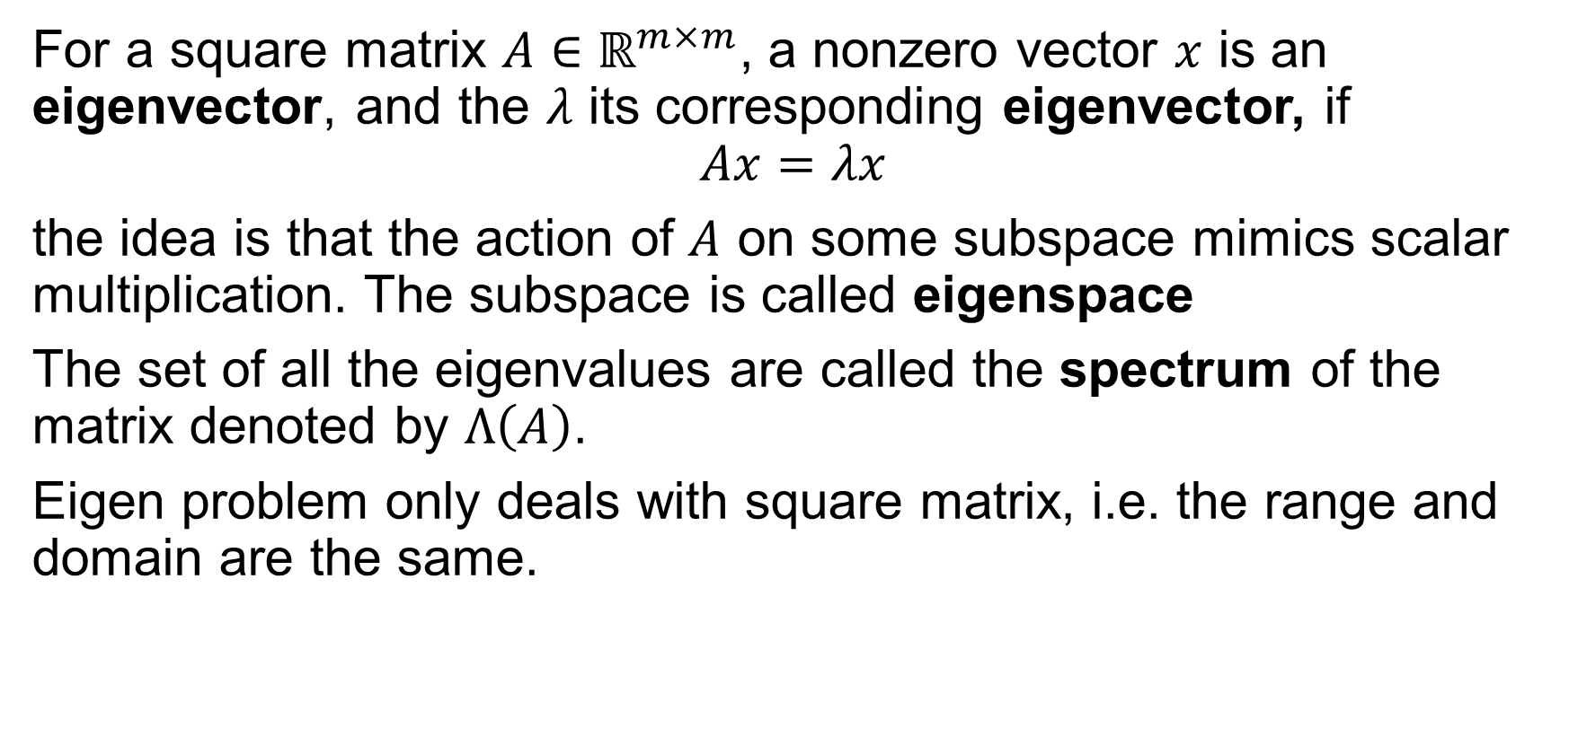
Basics of Eigenvalues/Eigenvectors
For a square matrix $A∈ℝ^{m×m}$, a nonzero vector $x$ is an eigenvector, and the $λ$ its corresponding eigenvector, if
$$Ax=λx$$
the idea is that the action of $A$ on some subspace mimics scalar multiplication. The subspace is called eigenspace
The set of all the eigenvalues are called the spectrum of the matrix denoted by $Λ\left(A\right)$.
Eigen problem only deals with square matrix, i.e. the range and domain are the same.

Slide 5
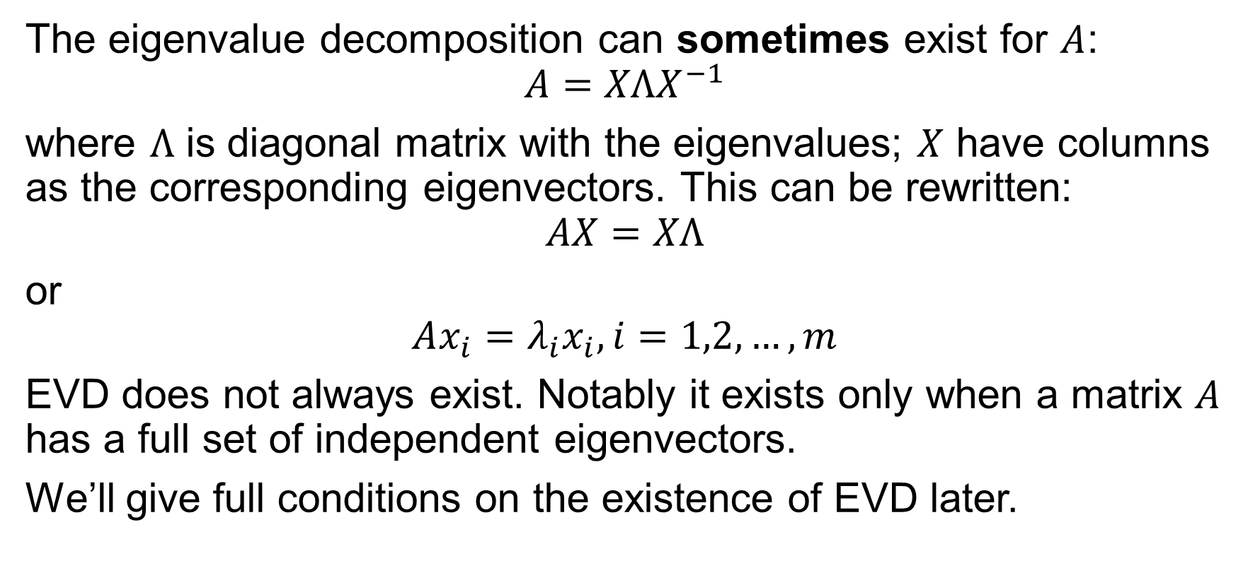
Eigenvalue Decomposition (EVD)
The eigenvalue decomposition can sometimes exist for $A$:
$$A=XΛX^{−1}$$
where $Λ$ is diagonal matrix with the eigenvalues; $X$ have columns as the corresponding eigenvectors. This can be rewritten:
$$AX=XΛ$$
or
$$Ax_{i}=λ_{i}x_{i}, i=1,2,…,m$$
EVD does not always exist. Notably it exists only when a matrix $A$ has a full set of independent eigenvectors.
We’ll give full conditions on the existence of EVD later.

Slide 6
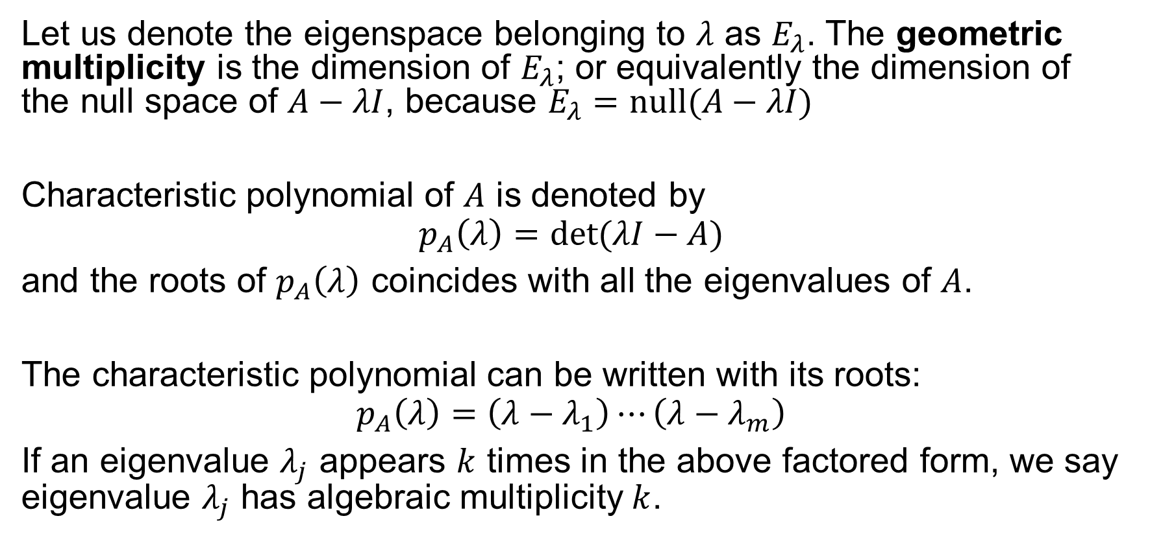
Characteristic Polynomials, Multiplicity
Let us denote the eigenspace belonging to $λ$ as $E_{λ}$. The geometric multiplicity is the dimension of $E_{λ}$; or equivalently the dimension of the null space of $A−λI$, because $E_{λ}=null(A−λI)$
Characteristic polynomial of $A$ is denoted by
$$p_{A}\left(λ\right)=det(λI−A)$$
and the roots of $p_{A}\left(λ\right)$ coincides with all the eigenvalues of $A$.
The characteristic polynomial can be written with its roots:
$$p_{A}\left(λ\right)=\left(λ−λ_{1}\right)⋯\left(λ−λ_{m}\right)$$
If an eigenvalue $λ_{j}$ appears $k$ times in the above factored form, we say eigenvalue $λ_{j}$ has algebraic multiplicity $k$.

Slide 7
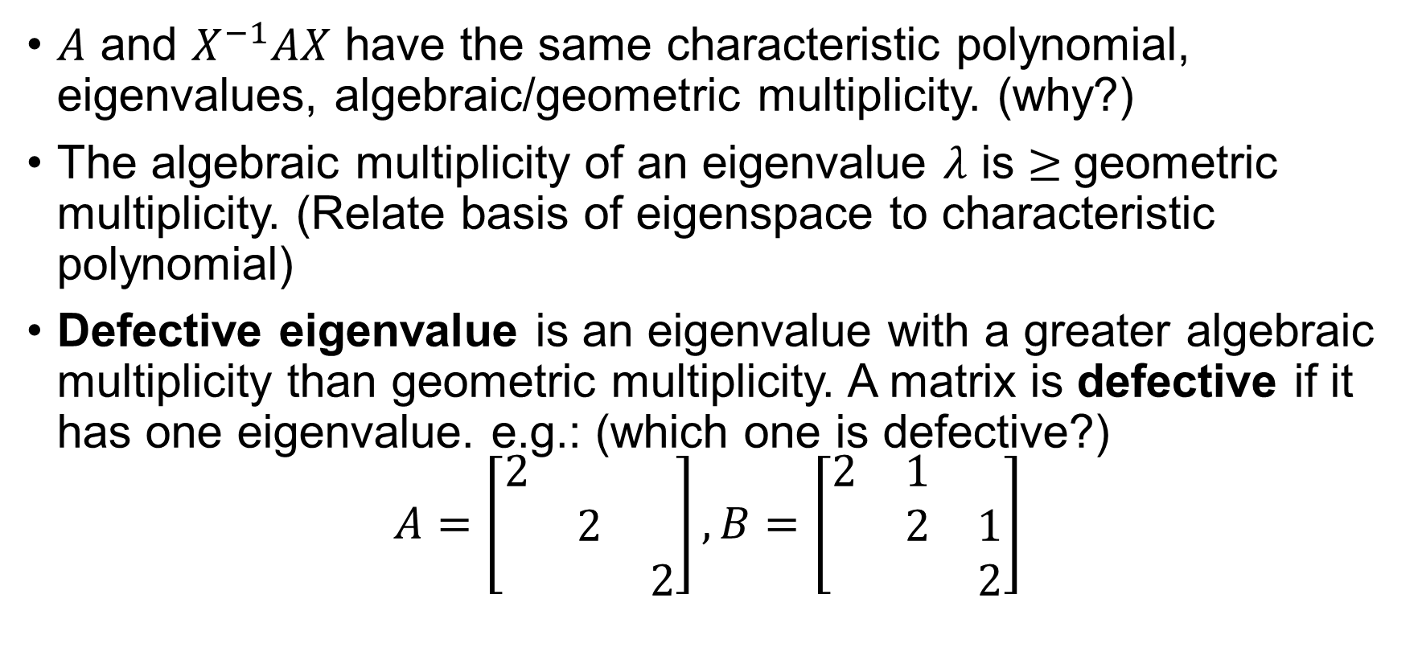
Similarity transformation
$A$ and $X^{−1}AX$ have the same characteristic polynomial, eigenvalues, algebraic/geometric multiplicity. (why?)
The algebraic multiplicity of an eigenvalue $λ$ is $≥$geometric multiplicity. (Relate basis of eigenspace to characteristic polynomial)
Defective eigenvalue is an eigenvalue with a greater algebraic multiplicity than geometric multiplicity. A matrix is defective if it has one eigenvalue. e.g.: (which one is defective?)
$$A=\left[\begin{matrix}2 & & \\ & 2 & \\ & & 2\end{matrix}\right], B=\left[\begin{matrix}2 & 1 & \\ & 2 & 1 \\ & & 2\end{matrix}\right]$$

Slide 8
What matrix have EVD?
If and only if it’s non-defective.
non-defective ⬄ EVD exists ⬄ diagonalizable ⬄ has m independent eigenvectors

Slide 9
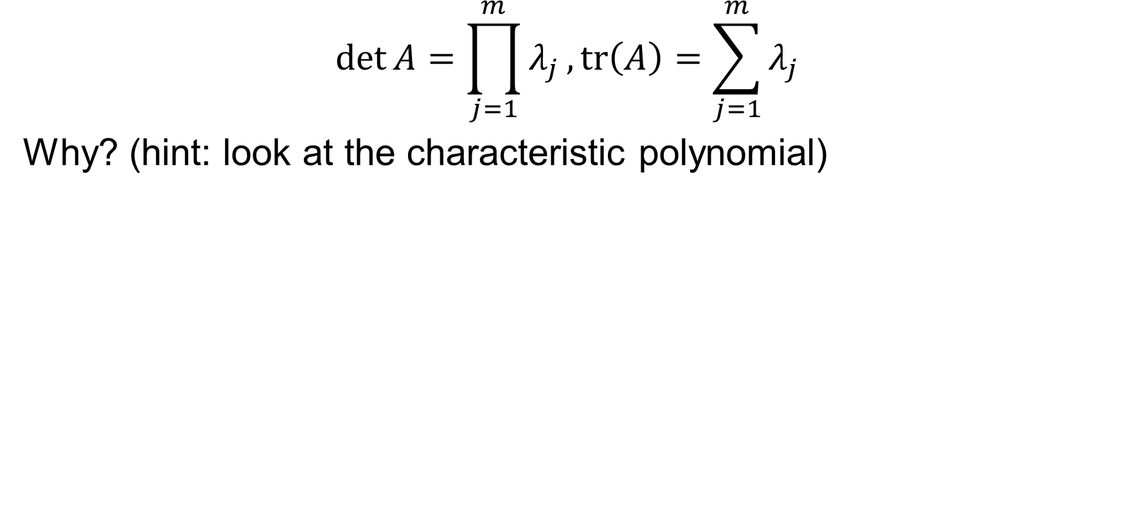
Determinant and Trace
$$\det{A}=\prod_{j=1}^{m}{λ_{j}}, tr\left(A\right)=\sum_{j=1}^{m}{λ_{j}}$$
Why? (hint: look at the characteristic polynomial)

Slide 10
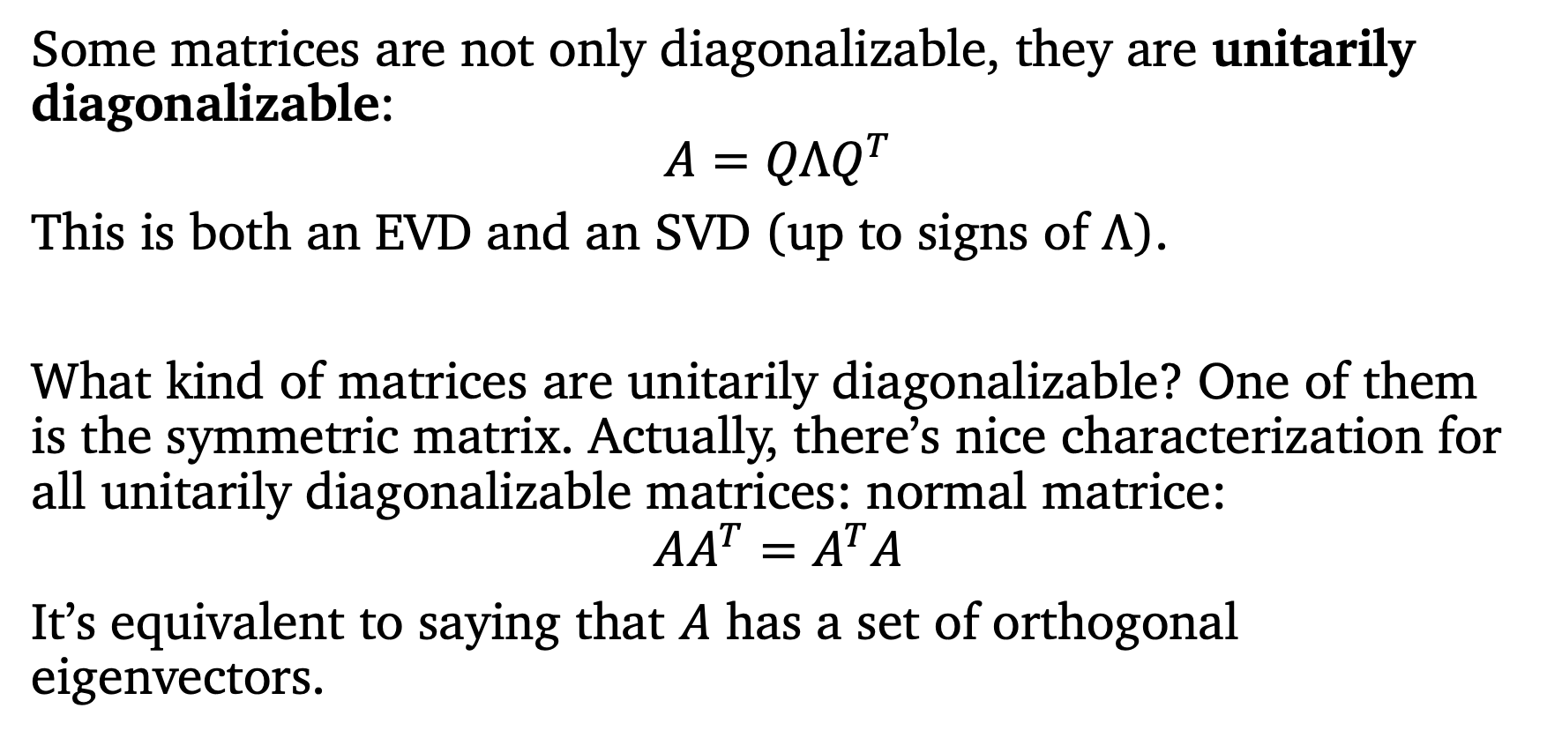
Normal matrices
Some matrices are not only diagonalizable, they are unitarily diagonalizable:
$$A=QΛQ^{T}$$
This is both an EVD and an SVD (up to signs of $Λ$).
What kind of matrices are unitarily diagonalizable? One of them is the symmetric matrix. Actually, there’s nice characterization for all unitarily diagonalizable matrices: normal matrice:
$$AA^{T}=A^{T}A$$
It’s equivalent to saying that $A$ has a set of orthogonal eigenvectors.

Slide 11
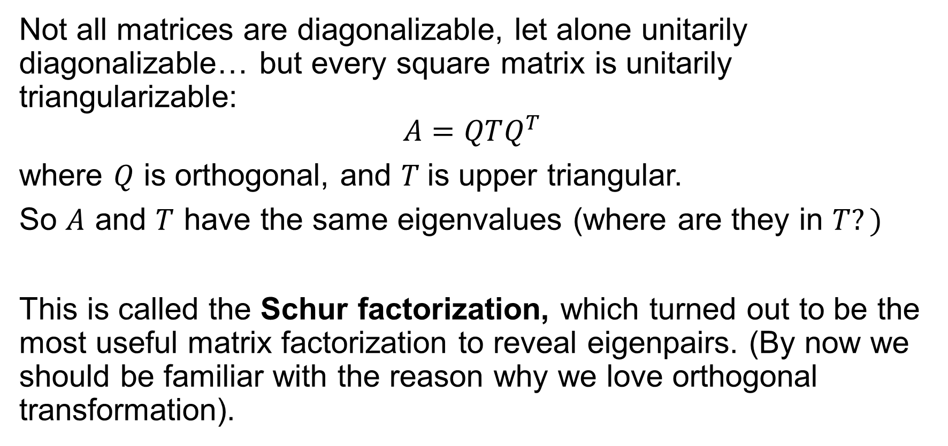
Schur Factorization
Not all matrices are diagonalizable, let alone unitarily diagonalizable… but every square matrix is unitarily triangularizable:
$$A=QTQ^{T}$$
where $Q$ is orthogonal, and $T$is upper triangular.
So $A$ and $T$ have the same eigenvalues (where are they in $T?)$
This is called the Schur factorization, which turned out to be the most useful matrix factorization to reveal eigenpairs. (By now we should be familiar with the reason why we love orthogonal transformation).

Slide 12
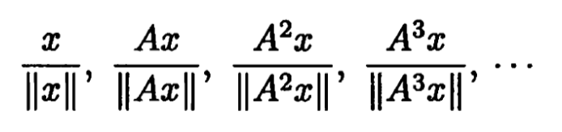
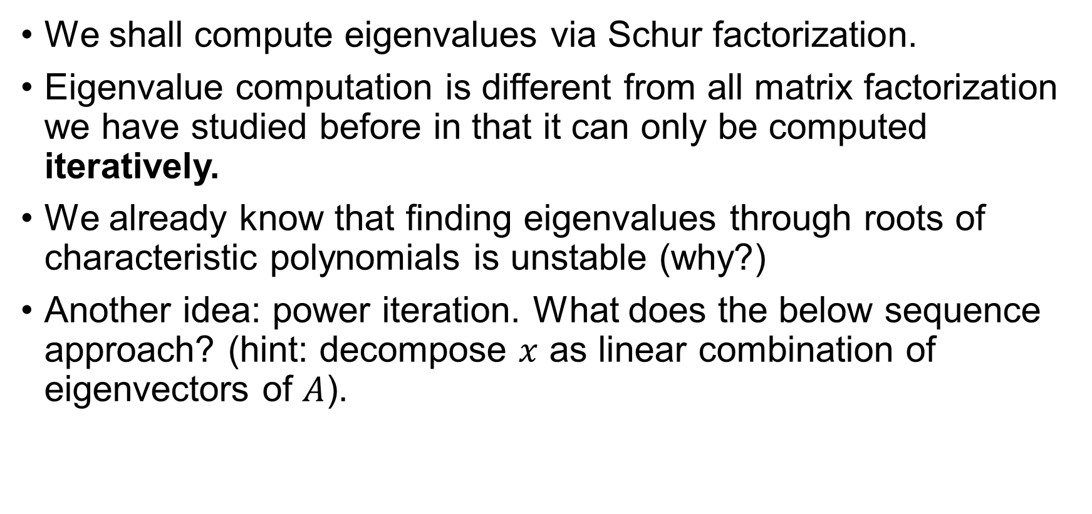
Overview of Eigenvalue Algorithms
We shall compute eigenvalues via Schur factorization.
Eigenvalue computation is different from all matrix factorization we have studied before in that it can only be computed iteratively.
We already know that finding eigenvalues through roots of characteristic polynomials is unstable (why?)
Another idea: power iteration. What does the below sequence approach? (hint: decompose $x$ as linear combination of eigenvectors of $A$).

Slide 13
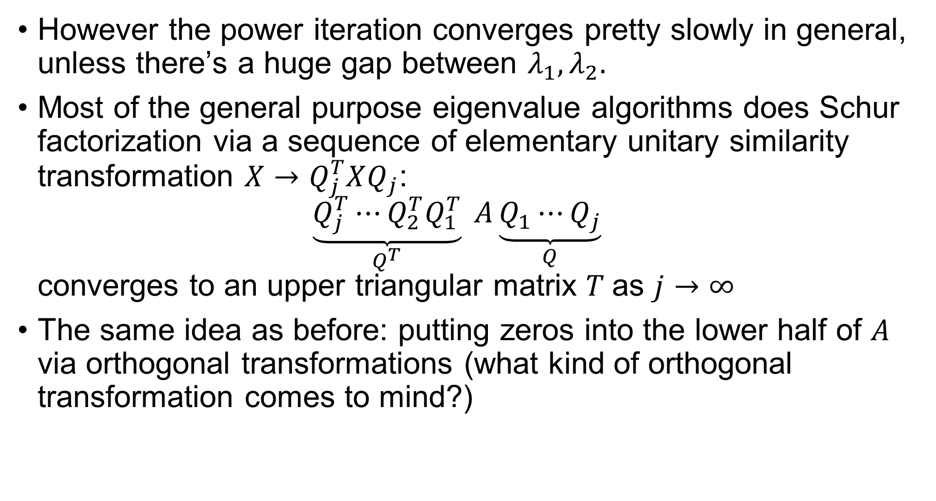
However the power iteration converges pretty slowly in general, unless there’s a huge gap between $λ_{1},λ_{2}.$
Most of the general purpose eigenvalue algorithms does Schur factorization via a sequence of elementary unitary similarity transformation $X→Q_{j}^{T}XQ_{j}$: $\underset{Q^{T}}{\underbrace{Q_{j}^{T}⋯Q_{2}^{T}Q_{1}^{T}}} A\underset{Q}{\underbrace{Q_{1}⋯Q_{j}}}$ converges to an upper triangular matrix $T$as $j→∞$
The same idea as before: putting zeros into the lower half of $A$ via orthogonal transformations (what kind of orthogonal transformation comes to mind?)

Slide 14
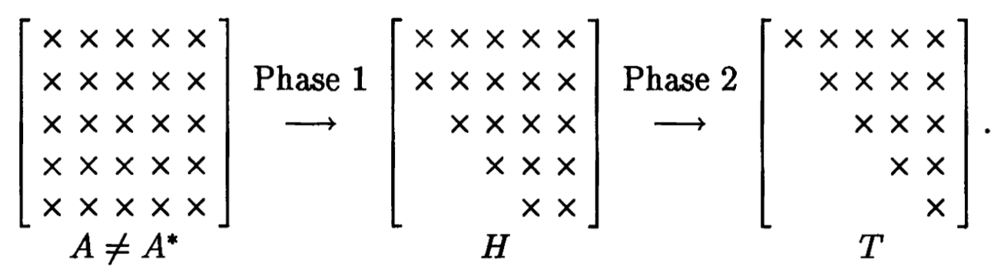
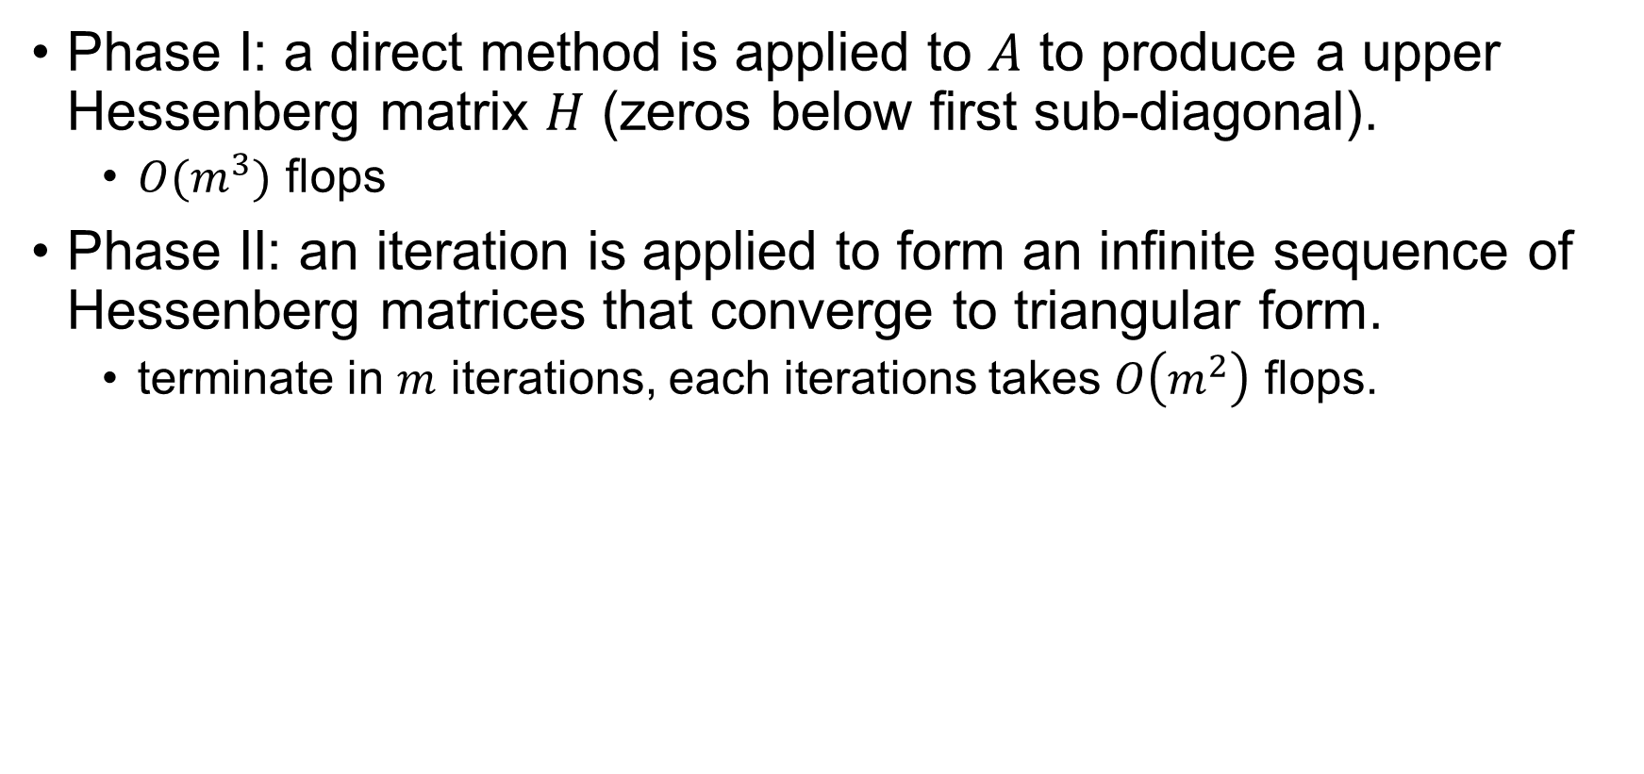
Two Phases Algorithm
Phase I: a direct method is applied to $A$ to produce a upper Hessenberg matrix $H$ (zeros below first sub-diagonal).
$O(m^{3})$ flops
Phase II: an iteration is applied to form an infinite sequence of Hessenberg matrices that converge to triangular form.
terminate in $m$ iterations, each iterations takes $O\left(m^{2}\right)$ flops.

Slide 15
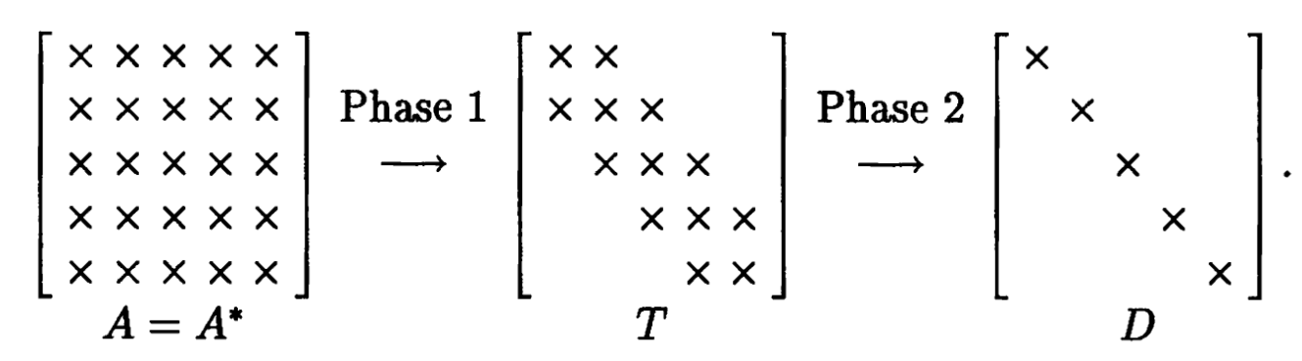
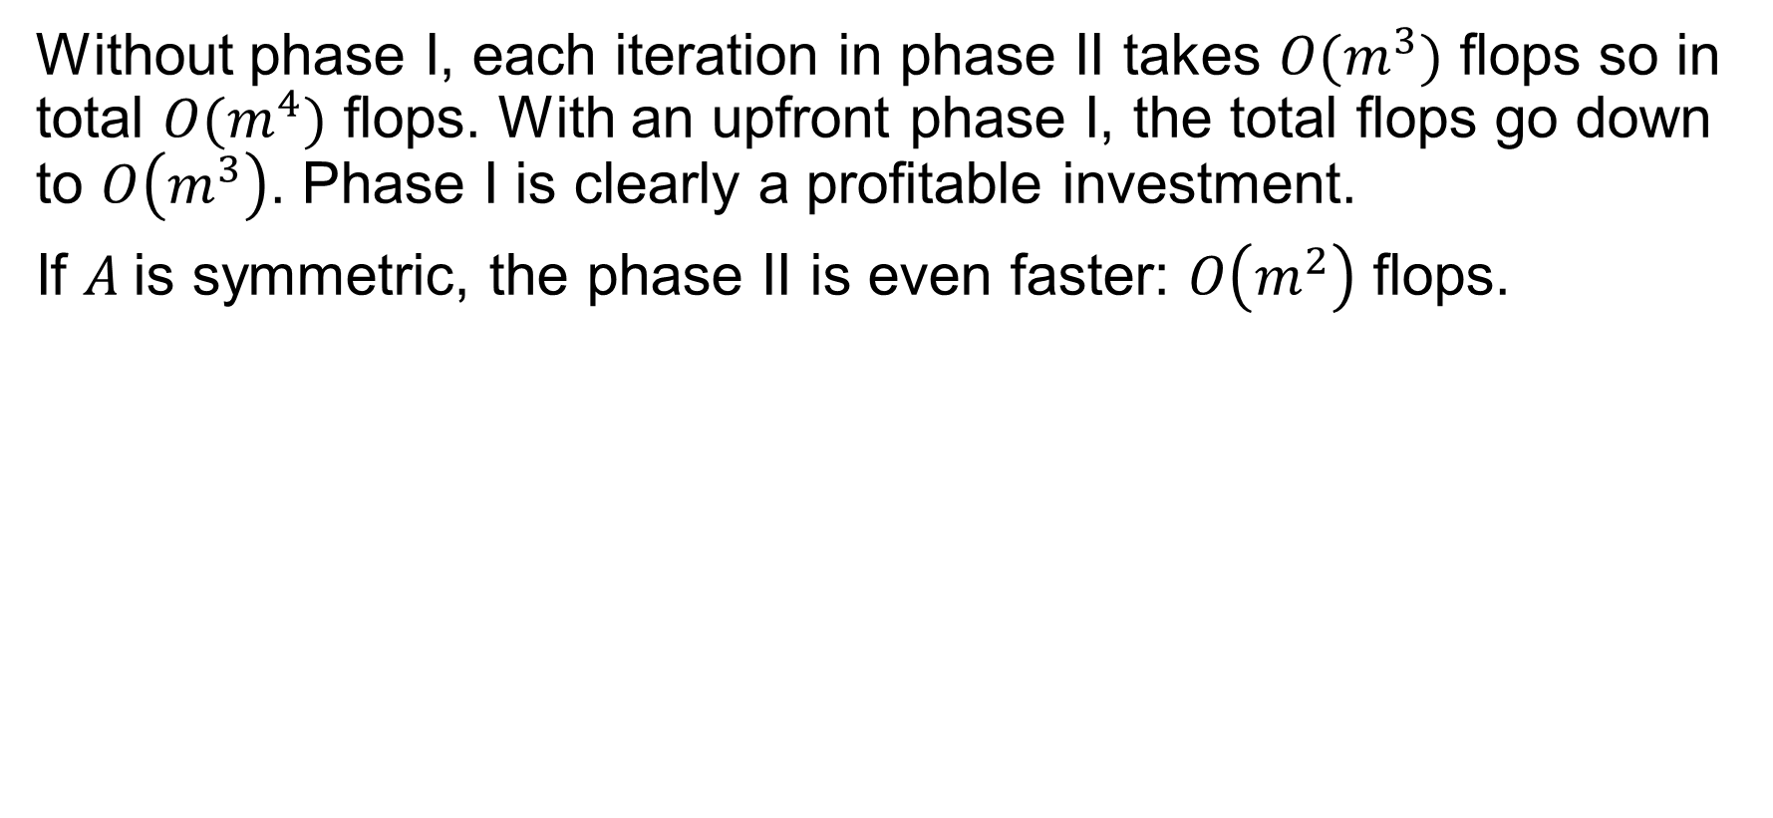
Why two phases?
Without phase I, each iteration in phase II takes $O(m^{3})$ flops so in total $O(m^{4})$ flops. With an upfront phase I, the total flops go down to $O\left(m^{3}\right)$. Phase I is clearly a profitable investment.
If $A$is symmetric, the phase II is even faster: $O\left(m^{2}\right)$ flops.

Slide 16
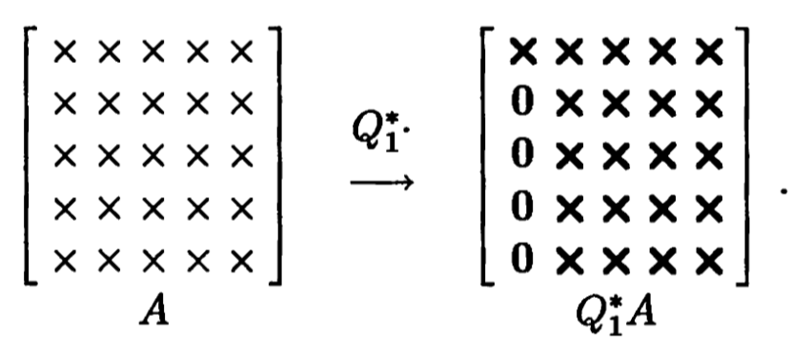
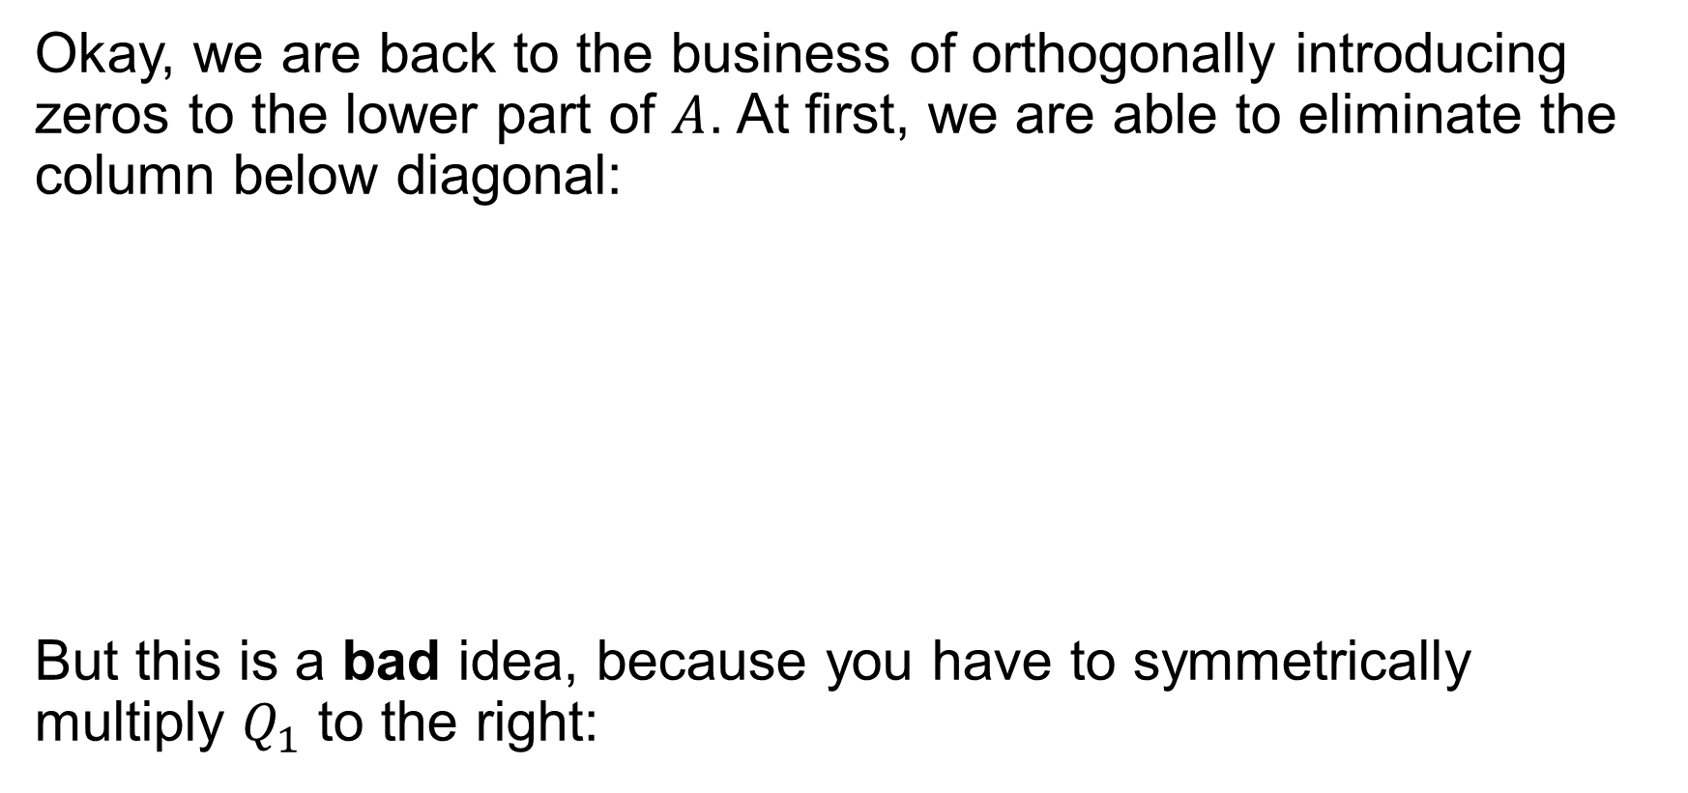
Phase I: Reduction to Hessenberg
Okay, we are back to the business of orthogonally introducing zeros to the lower part of $A$. At first, we are able to eliminate the column below diagonal:
But this is a bad idea, because you have to symmetrically multiply $Q_{1}$ to the right:

Slide 17
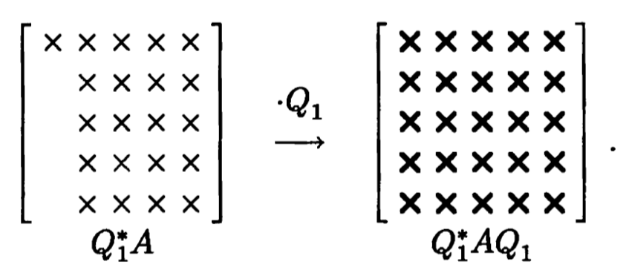

Unfortunately, the right application of $Q_{1}$ destroys our newly introduced zeros…

Slide 18
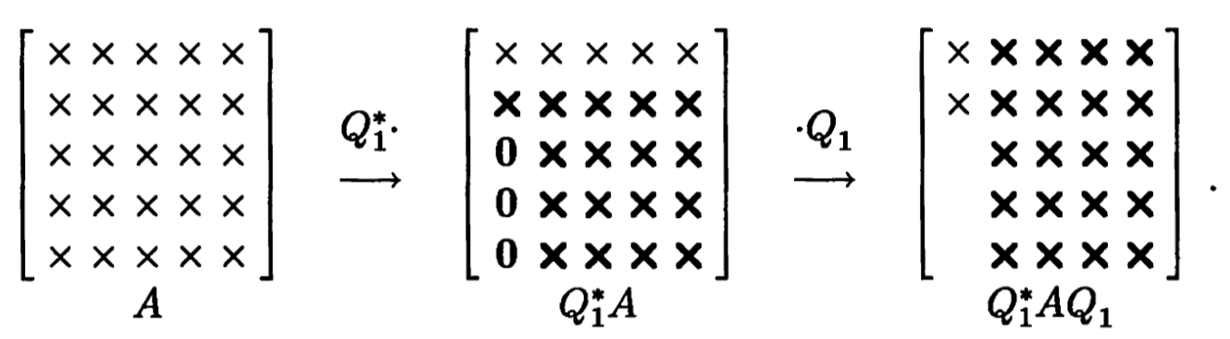
A better idea
We can’t eliminate all below diagonal; let’s step back and eliminate all below sub-diagonal:
It preserves the zeros! We successfully reduced some zeros..
Continuing this process, what do we get?

Slide 19
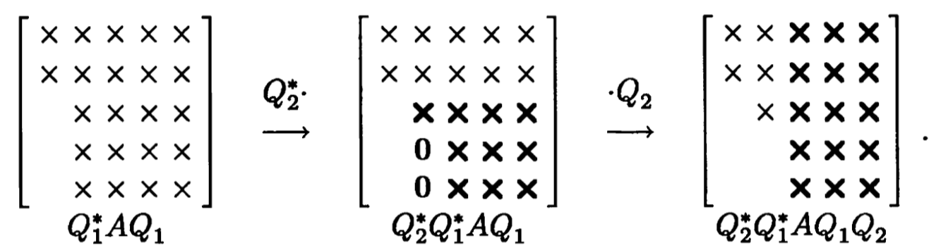
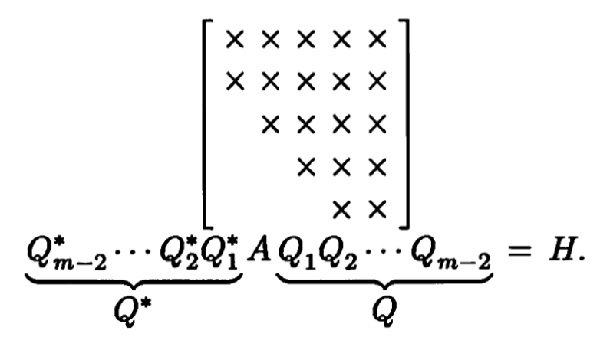
The second iteration. Eventually, we are getting:

Slide 20
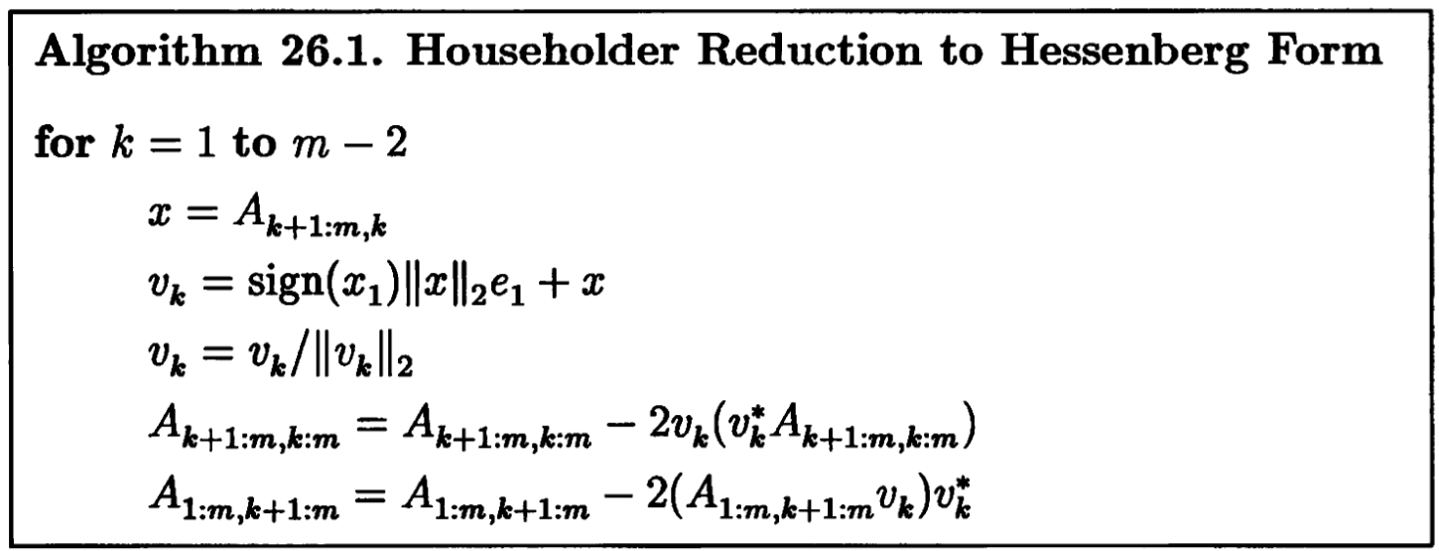
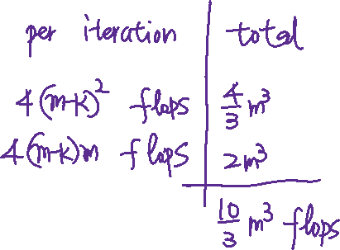
Algorithm

Slide 21
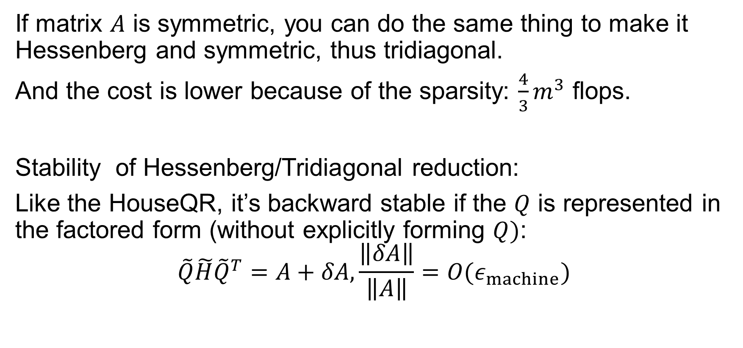
Reduction to tridiagonal
If matrix $A$ is symmetric, you can do the same thing to make it Hessenberg and symmetric, thus tridiagonal.
And the cost is lower because of the sparsity: $\frac{4}{3}m^{3}$ flops.
Stability of Hessenberg/Tridiagonal reduction:
Like the HouseQR, it’s backward stable if the $Q$ is represented in the factored form (without explicitly forming $Q)$:
$$\tilde{Q}\tilde{H}{\tilde{Q}}^{T}=A+δA,\frac{\left\|δA\right\|}{\left\|A\right\|}=O(ε_{machine})$$

Slide 22
Phase II: Hessenberg to Triangular
Phase II is necessarily an iterative process. This is where the magic happens, because we are going to devise an iterative solver that converges cubically (every iteration triples the correct digits). This is incredibly fast convergence rate.
But we have to study the components of QR algorithm individually first:
Power iteration, inverse power iteration, and Rayleigh quotient iteration
The QR Algorithm without/with shift

Slide 23
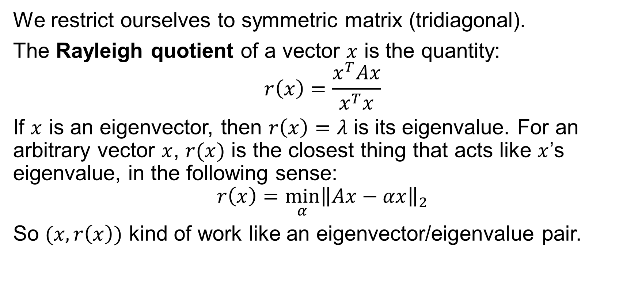
Rayleigh Quotient
We restrict ourselves to symmetric matrix (tridiagonal).
The Rayleigh quotient of a vector $x$ is the quantity:
$$r\left(x\right)=\frac{x^{T}Ax}{x^{T}x}$$
If $x$ is an eigenvector, then $r\left(x\right)=λ$ is its eigenvalue. For an arbitrary vector $x$, $r(x)$ is the closest thing that acts like $x$’s eigenvalue, in the following sense:
$$r\left(x\right)={\min_{α}\left\|Ax−αx\right\|}_{2}$$
So $(x,r\left(x\right))$ kind of work like an eigenvector/eigenvalue pair.

Slide 24
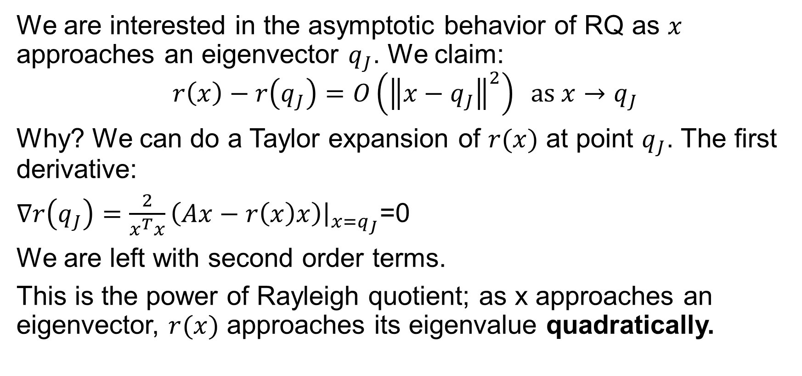
How Rayleigh quotient approaches eigenvalue
We are interested in the asymptotic behavior of RQ as $x$ approaches an eigenvector $q_{J}$. We claim:
$$r\left(x\right)−r\left(q_{J}\right)=O\left({\left\|x−q_{J}\right\|}^{2}\right) \text{as} x→q_{J}$$
Why? We can do a Taylor expansion of $r(x)$ at point $q_{J}$. The first derivative:
$∇r\left(q_{J}\right)=\frac{2}{x^{T}x}\left(Ax−r\left(x\right)x\right){\left.​\right|}_{x=q_{J}}$=0
We are left with second order terms.
This is the power of Rayleigh quotient; as x approaches an eigenvector, $r(x)$ approaches its eigenvalue quadratically.

Slide 25
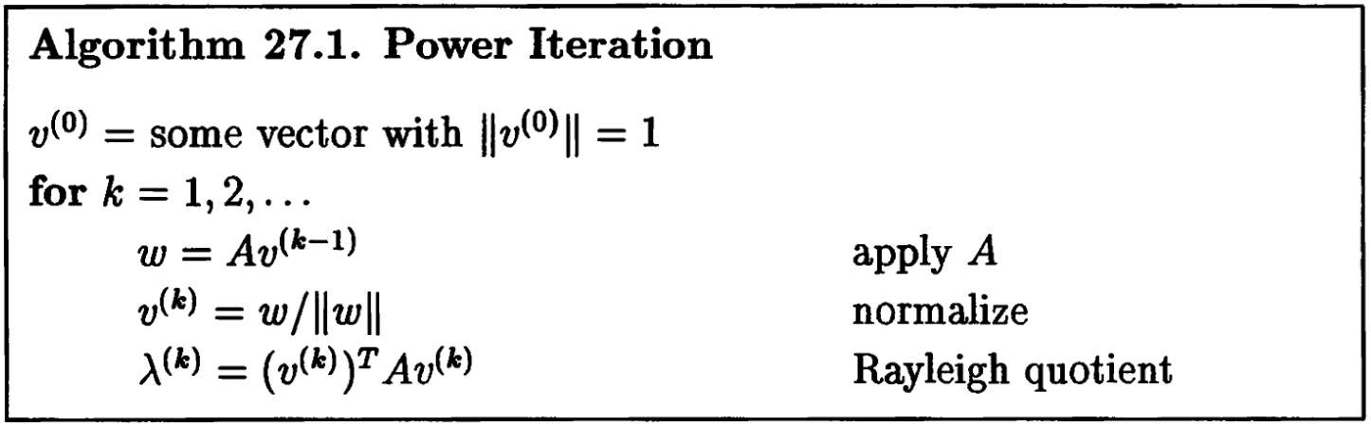
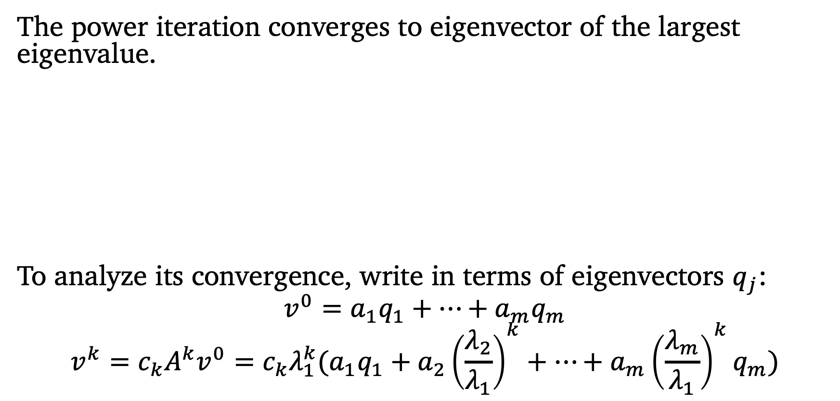
Power Iteration
The power iteration converges to eigenvector of the largest eigenvalue.
To analyze its convergence, write in terms of eigenvectors $q_{j}$:
$$v^{0}=a_{1}q_{1}+⋯+a_{m}q_{m}$$
$$v^{k}=c_{k}A^{k}v^{0}=c_{k}λ_{1}^{k}(a_{1}q_{1}+a_{2}{\left(\frac{λ_{2}}{λ_{1}}\right)}^{k}+⋯+a_{m}{\left(\frac{λ_{m}}{λ_{1}}\right)}^{k}q_{m})$$

Slide 26
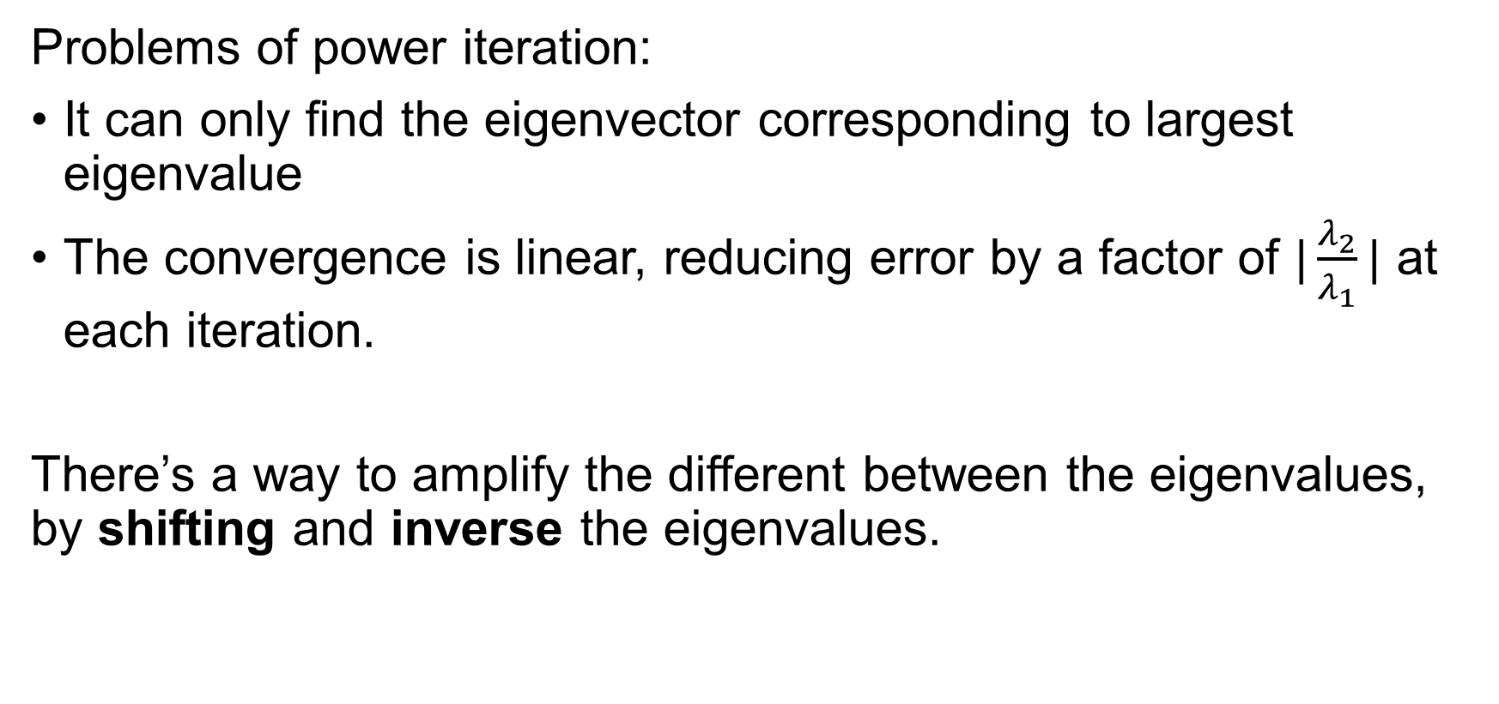
Inverse Power Iteration
Problems of power iteration:
It can only find the eigenvector corresponding to largest eigenvalue
The convergence is linear, reducing error by a factor of $|\frac{λ_{2}}{λ_{1}}|$ at each iteration.
There’s a way to amplify the different between the eigenvalues, by shifting and inverse the eigenvalues.

Slide 27
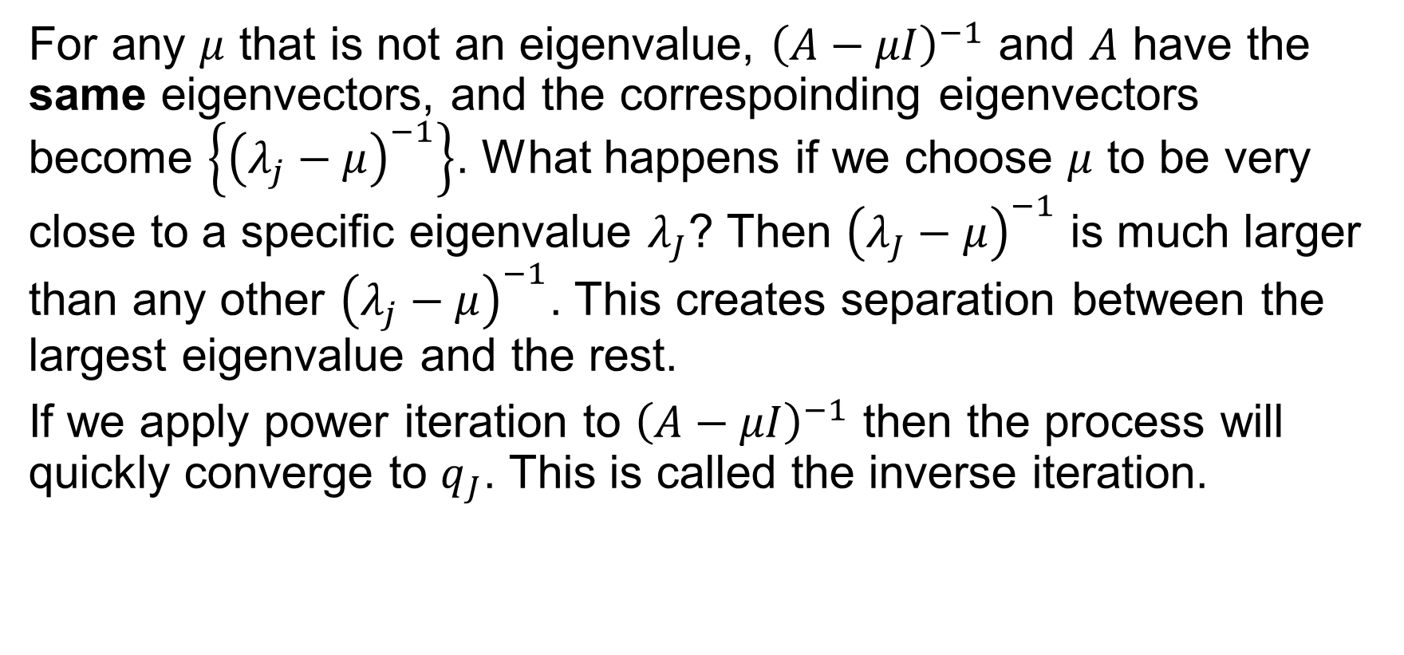
Inverse Iteration
For any $μ$ that is not an eigenvalue, ${\left(A−μI\right)}^{−1}$ and $A$ have the same eigenvectors, and the correspoinding eigenvectors become $\left\{{\left(λ_{j}−μ\right)}^{−1}\right\}$. What happens if we choose $μ$ to be very close to a specific eigenvalue $λ_{J}$? Then ${\left(λ_{J}−μ\right)}^{−1}$ is much larger than any other ${\left(λ_{j}−μ\right)}^{−1}$. This creates separation between the largest eigenvalue and the rest.
If we apply power iteration to ${\left(A−μI\right)}^{−1}$ then the process will quickly converge to $q_{J}$. This is called the inverse iteration.

Slide 28
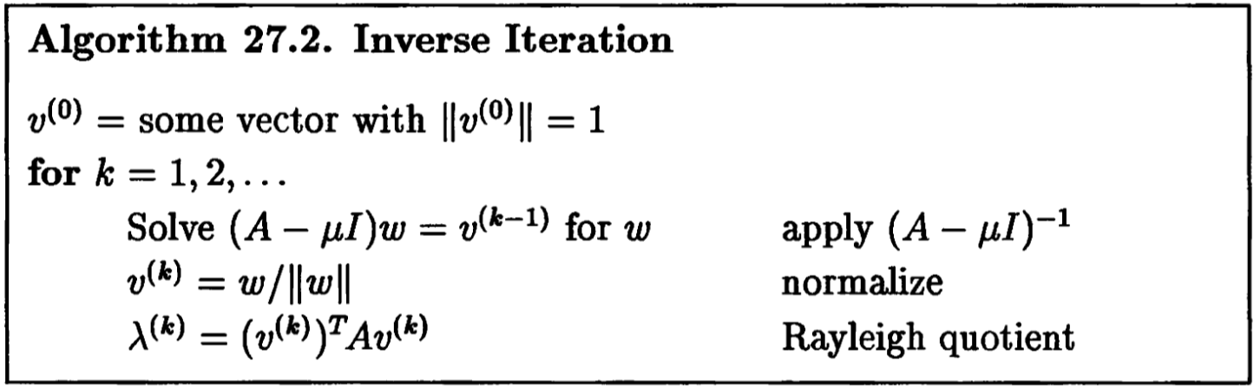
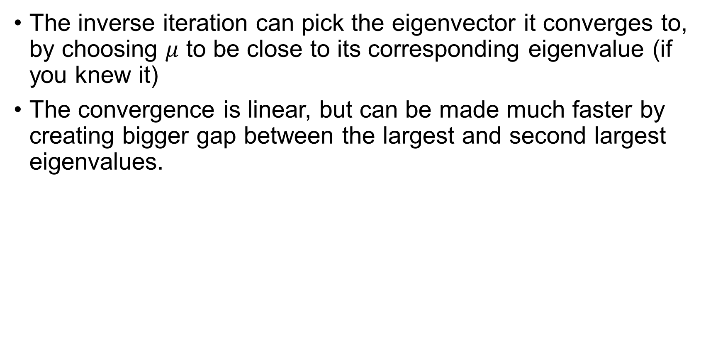
Inverse Iteration Algorithm
The inverse iteration can pick the eigenvector it converges to, by choosing $μ$ to be close to its corresponding eigenvalue (if you knew it)
The convergence is linear, but can be made much faster by creating bigger gap between the largest and second largest eigenvalues.

Slide 29
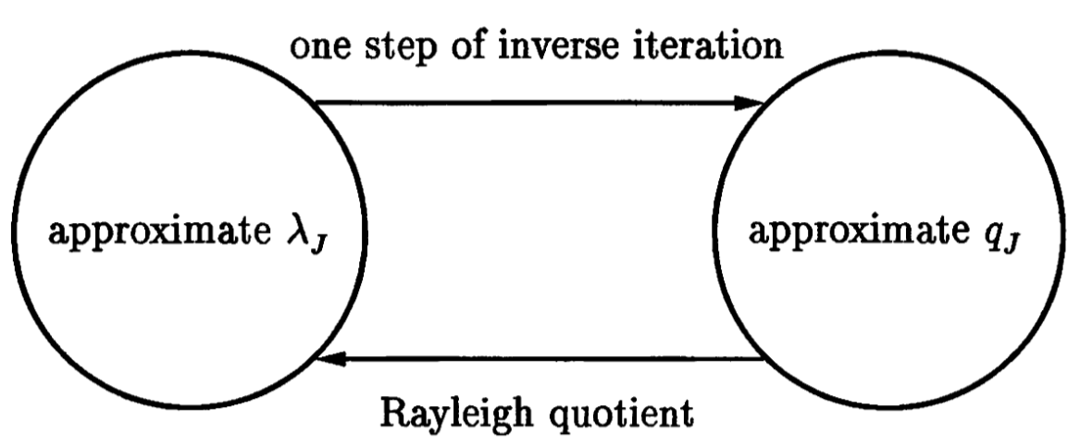
Combination
So far we have two good tools at hand:
Rayleigh quotient gives us a good eigenvalue estimate from an eigenvector estimate;
Inverse iteration gives us a good eigenvector estimate from an eigenvalue estimate.
See how they are perfectly made for each other?

Slide 30
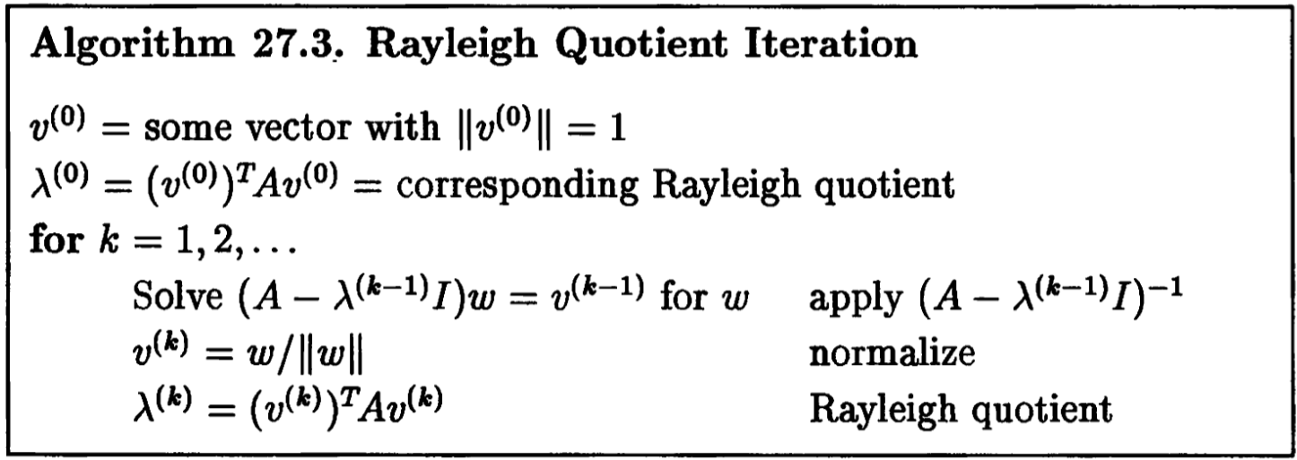
Rayleigh Quotient Iteration

Slide 31
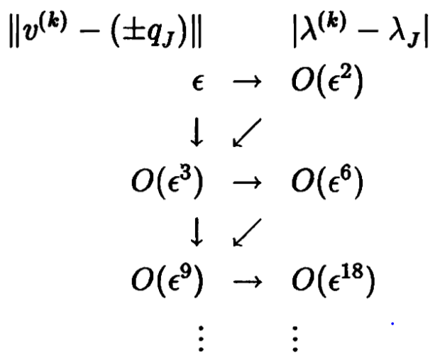
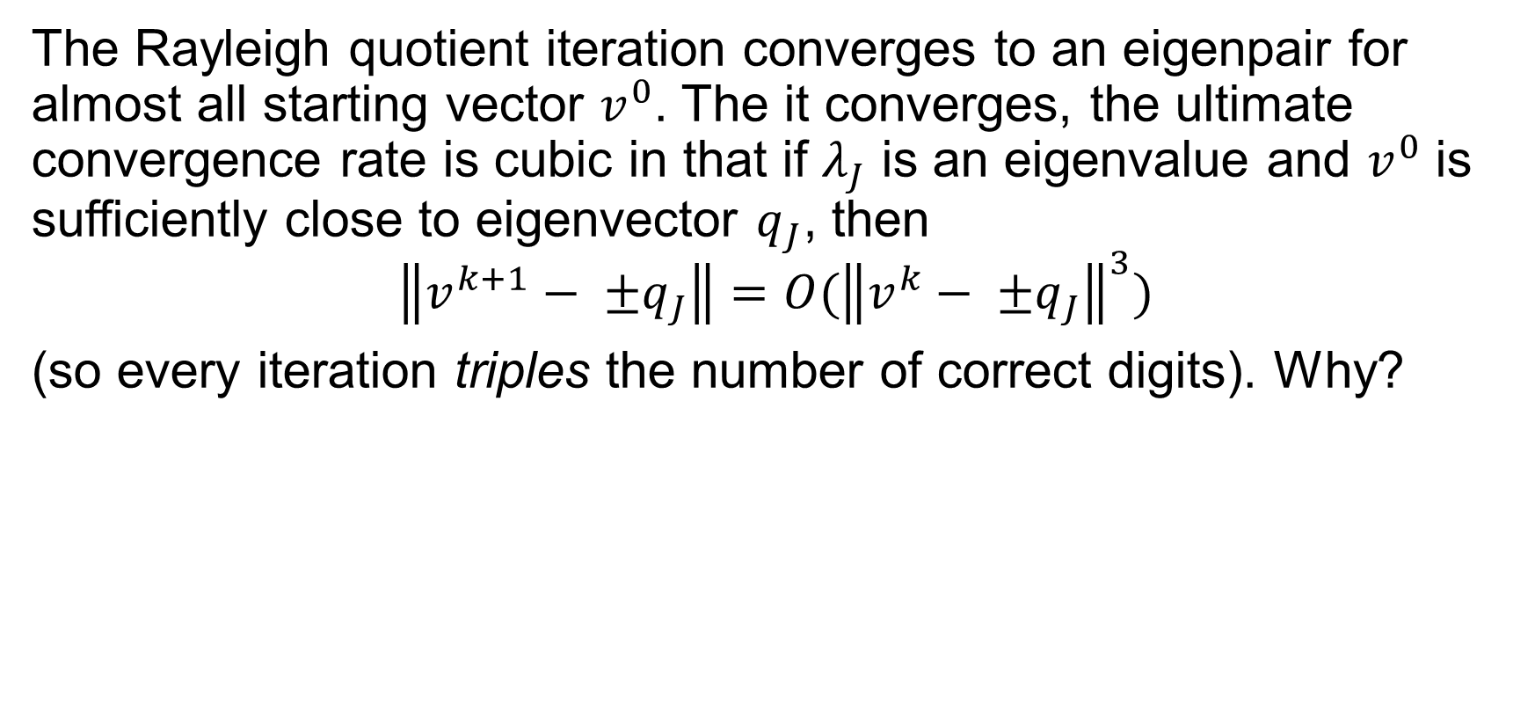
Convergence
The Rayleigh quotient iteration converges to an eigenpair for almost all starting vector $v^{0}$. The it converges, the ultimate convergence rate is cubic in that if $λ_{J}$ is an eigenvalue and $v^{0}$ is sufficiently close to eigenvector $q_{J}$, then
$$\left\|v^{k+1}− ±q_{J}\right\|=O({\left\|v^{k}− ±q_{J}\right\|}^{3})$$
(so every iteration triples the number of correct digits). Why?

Slide 32
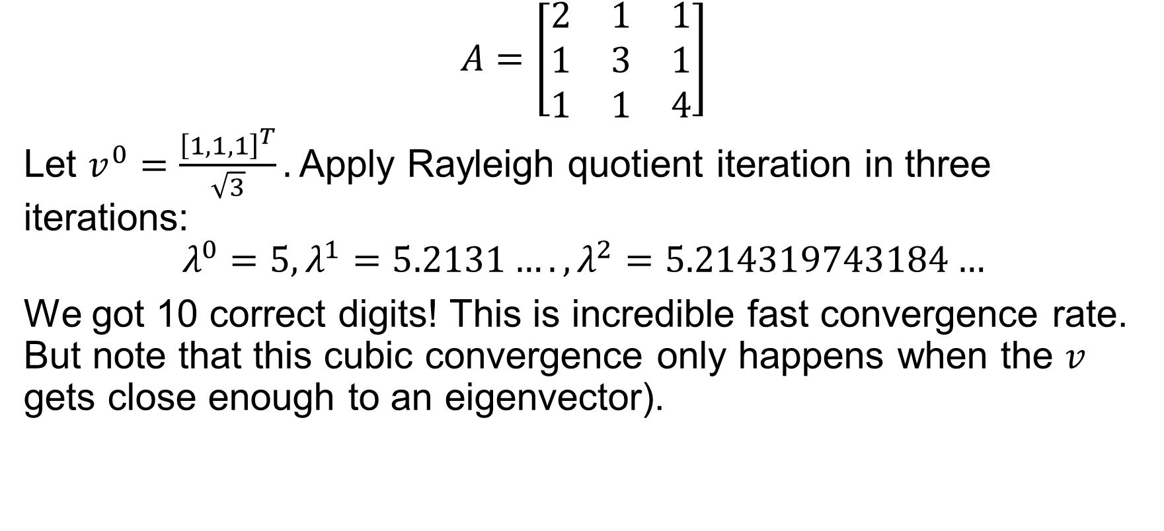
Example
$$A=\left[\begin{matrix}2 & 1 & 1 \\ 1 & 3 & 1 \\ 1 & 1 & 4\end{matrix}\right]$$
Let $v^{0}=\frac{{\left[1,1,1\right]}^{T}}{\sqrt{3}}.$ Apply Rayleigh quotient iteration in three iterations:
$$λ^{0}=5, λ^{1}=5.2131…., λ^{2}=5.214319743184…$$
We got 10 correct digits! This is incredible fast convergence rate. But note that this cubic convergence only happens when the $v$ gets close enough to an eigenvector).

Slide 33
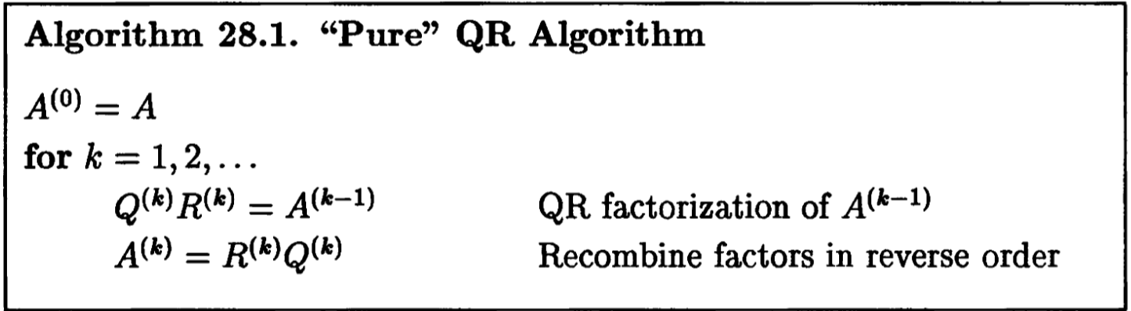
The QR Algorithm
Now that we have this incredibly quickly convergent Rayleigh Quotient Iteration that will give us… one eigenpair?
What if we need all of the eigenpairs? Can we do “simultaneous iterations”?
In fact we can, and the result is the jewel of numerical analysis: the QR algorithm. The pure QR algorithm is deceptively simple:

Slide 34
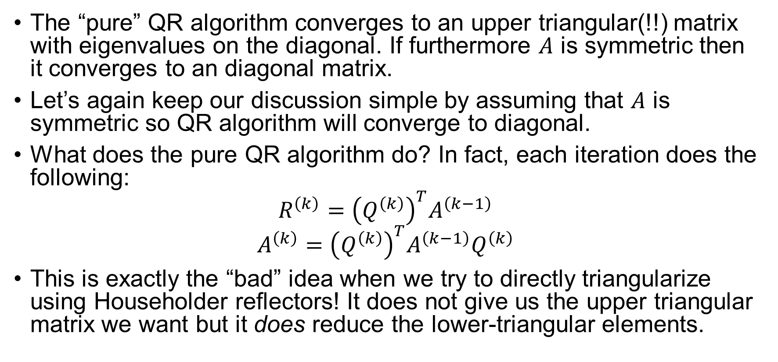
“Pure” QR Algorithm
The “pure” QR algorithm converges to an upper triangular(!!) matrix with eigenvalues on the diagonal. If furthermore $A$ is symmetric then it converges to an diagonal matrix.
Let’s again keep our discussion simple by assuming that $A$ is symmetric so QR algorithm will converge to diagonal.
What does the pure QR algorithm do? In fact, each iteration does the following:
$$R^{\left(k\right)}={\left(Q^{\left(k\right)}\right)}^{T}A^{\left(k−1\right)}$$
$$A^{\left(k\right)}={\left(Q^{\left(k\right)}\right)}^{T}A^{\left(k−1\right)}Q^{\left(k\right)}$$
This is exactly the “bad” idea when we try to directly triangularize using Householder reflectors! It does not give us the upper triangular matrix we want but it does reduce the lower-triangular elements.

Slide 35
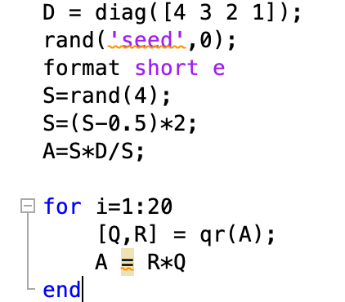
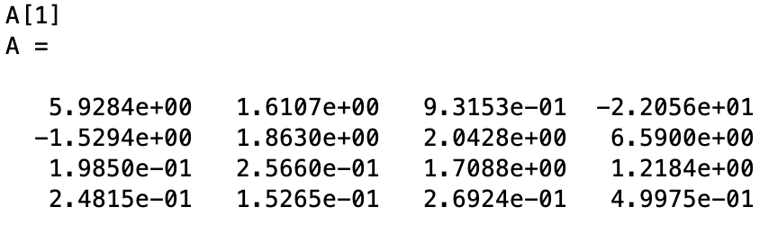
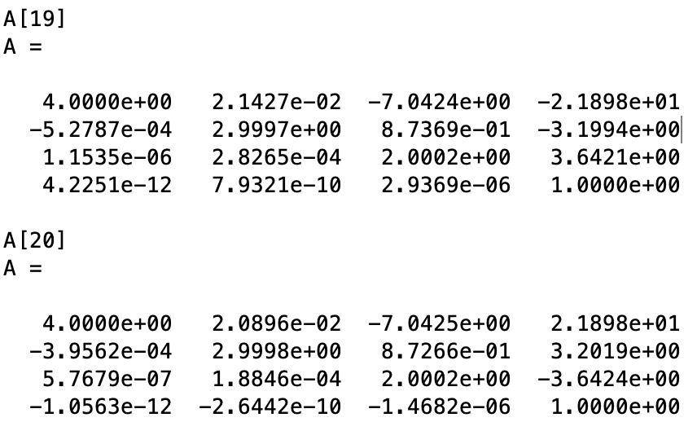
Example of pure QR algorithm
Matlab code
Result:

Slide 36
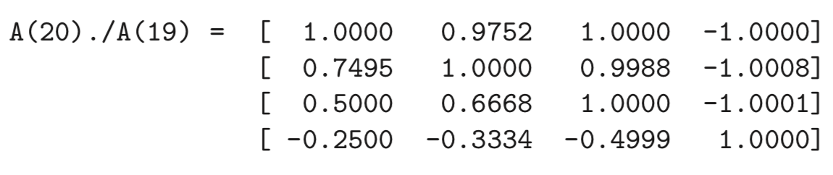
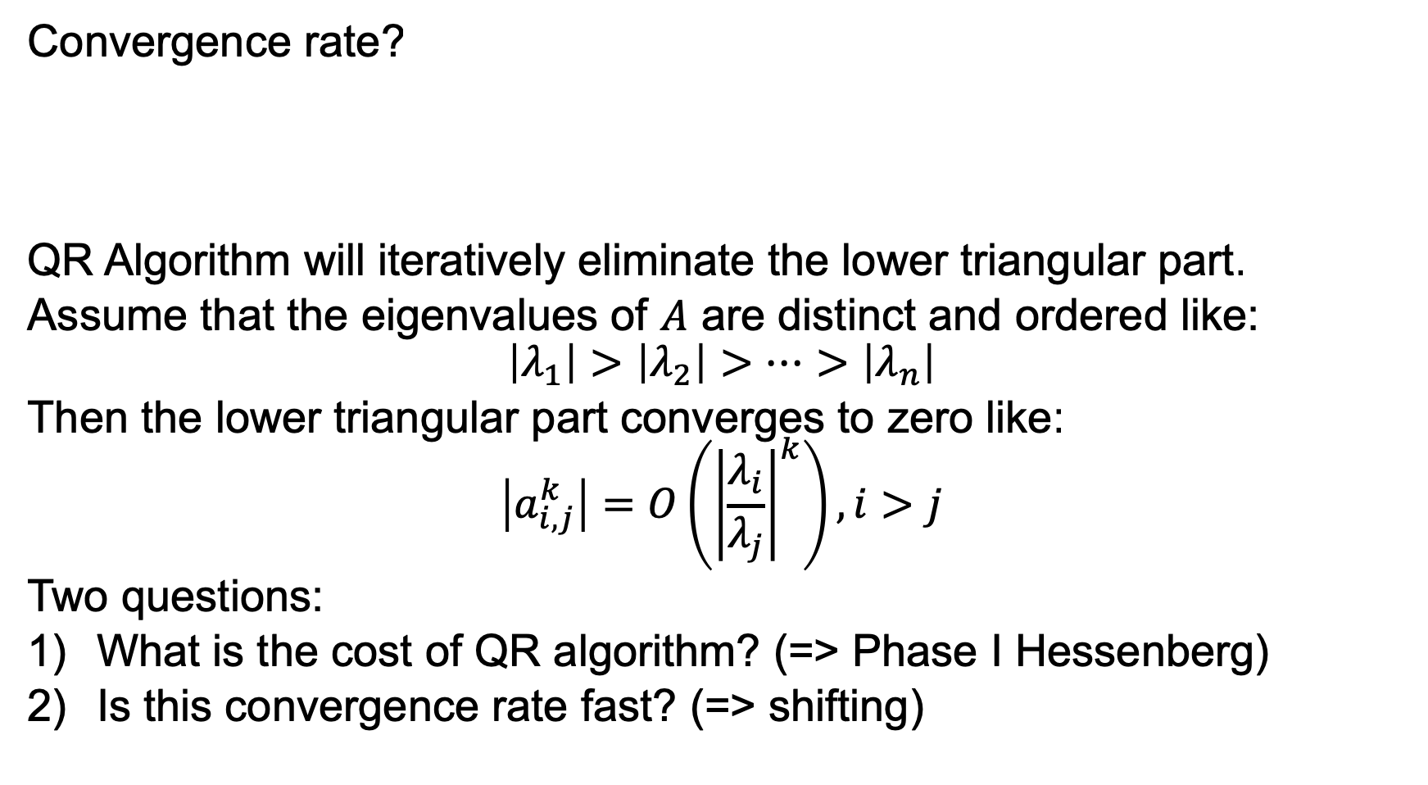
Convergence rate?
QR Algorithm will iteratively eliminate the lower triangular part.
Assume that the eigenvalues of $A$ are distinct and ordered like:
$$\left|λ_{1}\right|>\left|λ_{2}\right|>⋯>\left|λ_{n}\right|$$
Then the lower triangular part converges to zero like:
$$\left|a_{i,j}^{k}\right|=O\left({\left|\frac{λ_{i}}{λ_{j}}\right|}^{k}\right), i>j$$
Two questions:
What is the cost of QR algorithm? (=> Phase I Hessenberg)
Is this convergence rate fast? (=> shifting)

Slide 37
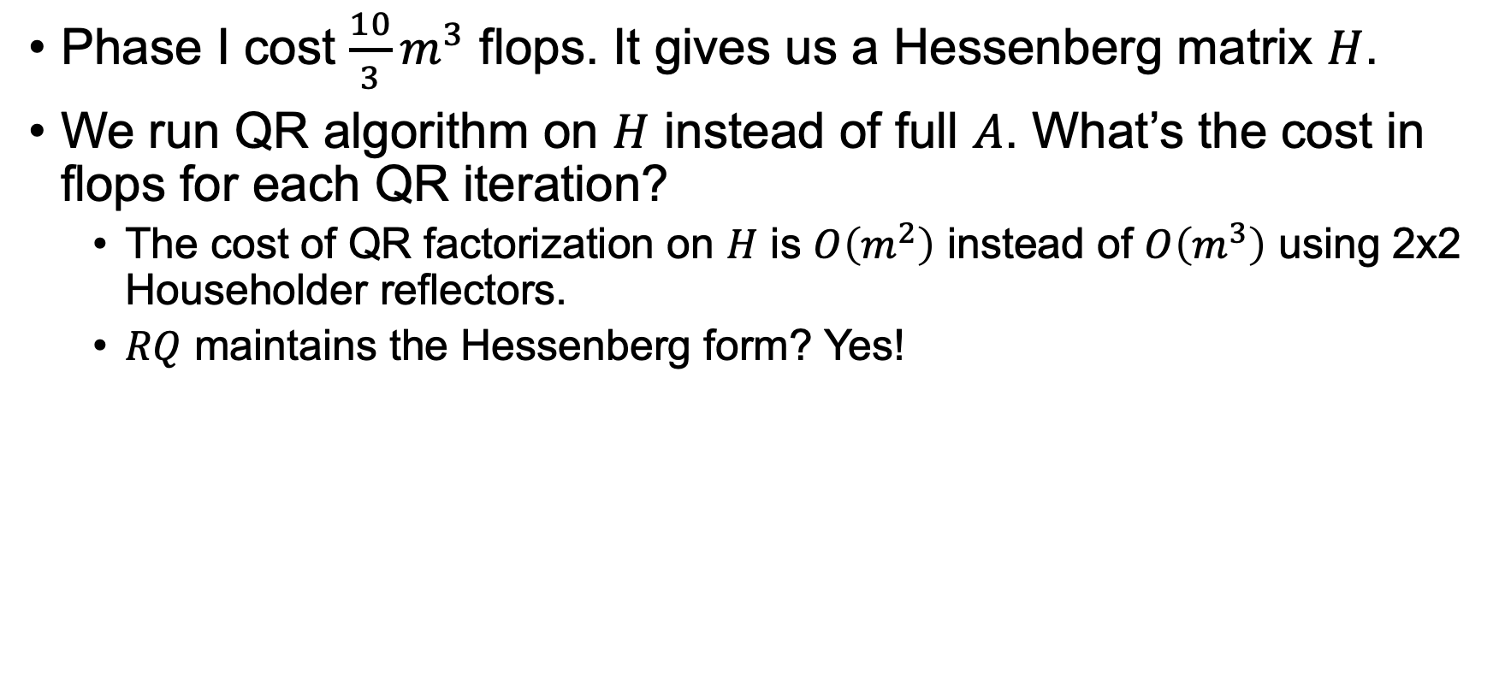
The purpose of Phase I
Phase I cost $\frac{10}{3}m^{3}$ flops. It gives us a Hessenberg matrix $H$.
We run QR algorithm on $H$ instead of full $A$. What’s the cost in flops for each QR iteration?
The cost of QR factorization on $H$ is $O\left(m^{2}\right)$ instead of $O\left(m^{3}\right)$ using 2x2 Householder reflectors.
$RQ$ maintains the Hessenberg form? Yes!

Slide 38
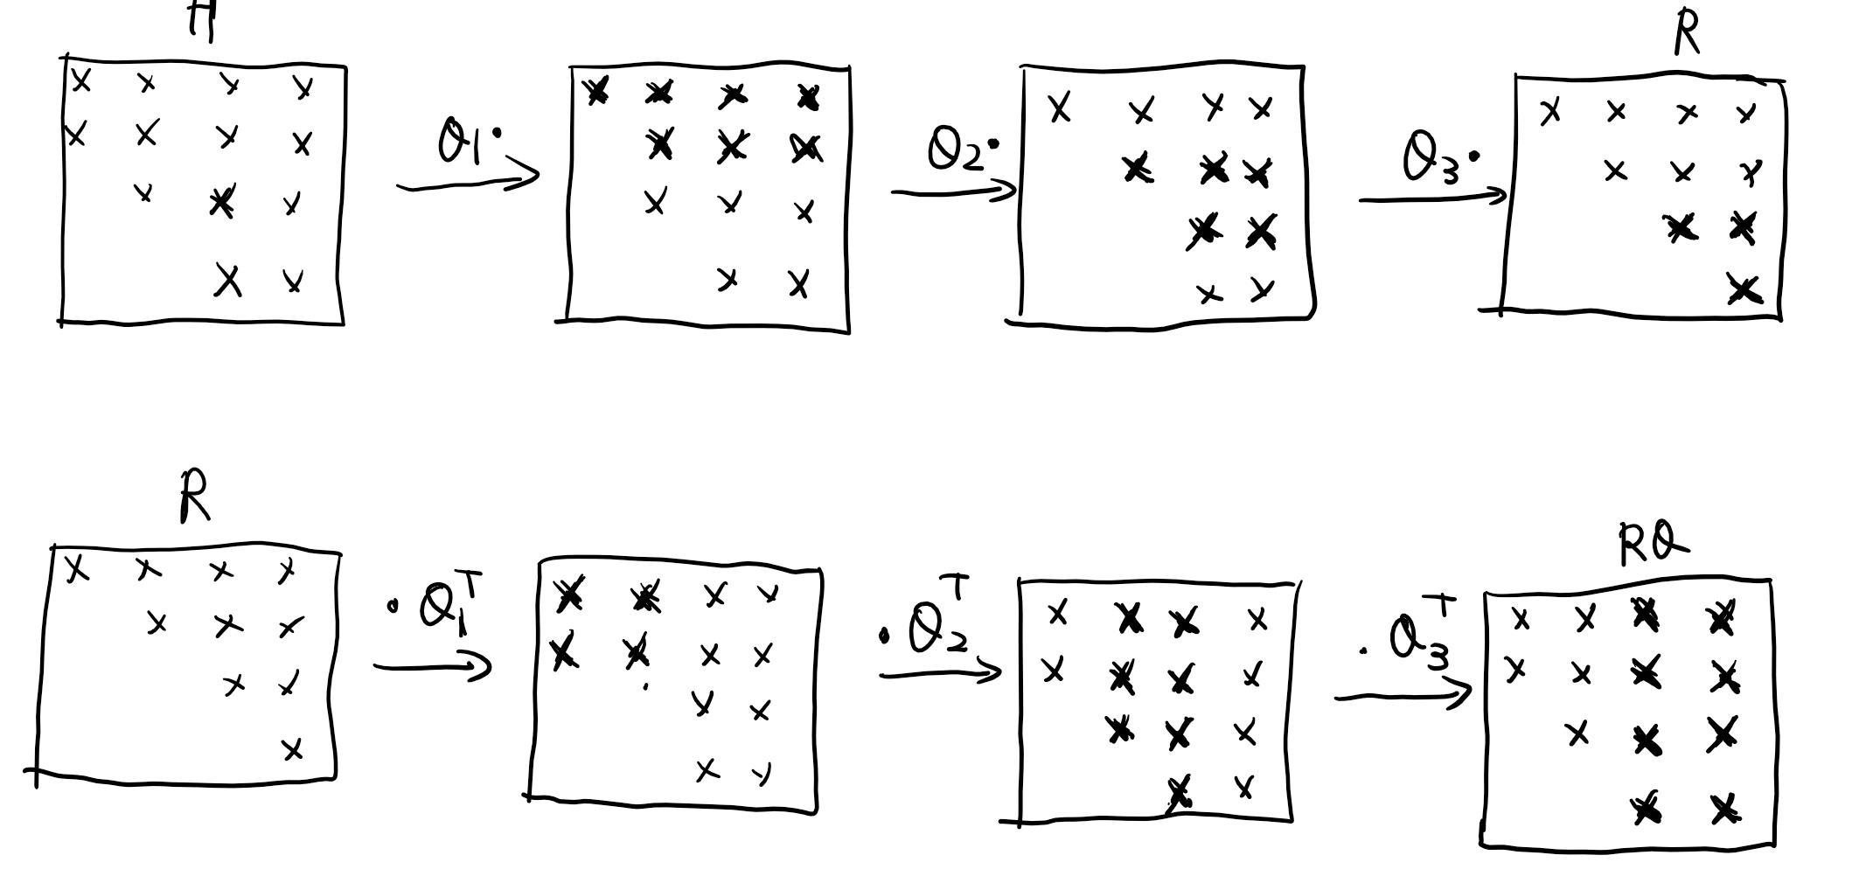

Slide 39
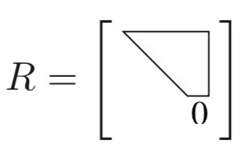
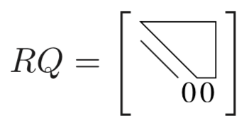
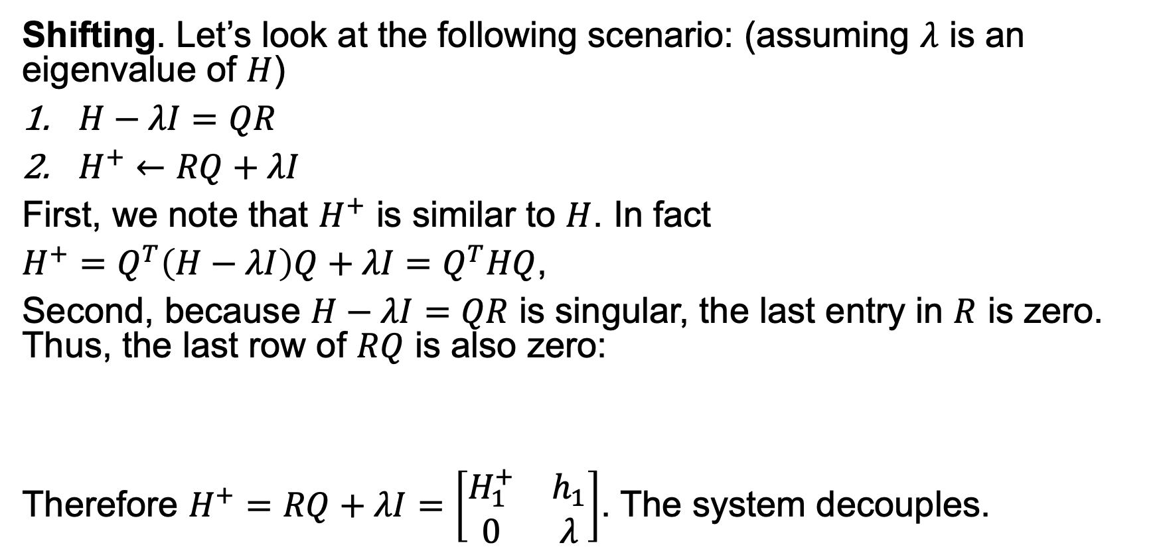
Improving the convergence rate
Shifting. Let’s look at the following scenario: (assuming $λ$ is an eigenvalue of $H$)
$H−λI=QR$
$H^{+}←RQ+λI$
First, we note that $H^{+}$ is similar to $H$. In fact
$H^{+}=Q^{T}\left(H−λI\right)Q+λI=Q^{T}HQ$,
Second, because $H−λI=QR$ is singular, the last entry in $R$ is zero. Thus, the last row of $RQ$ is also zero:
Therefore $H^{+}=RQ+λI=\left[\begin{matrix}H_{1}^{+} & h_{1} \\ 0 & λ\end{matrix}\right]$. The system decouples.

Slide 40
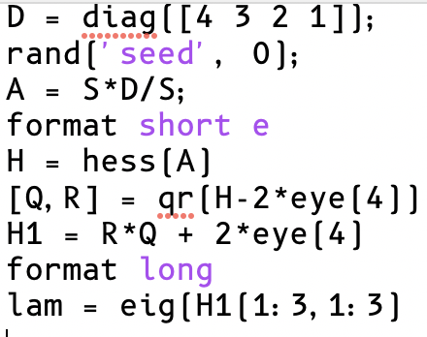
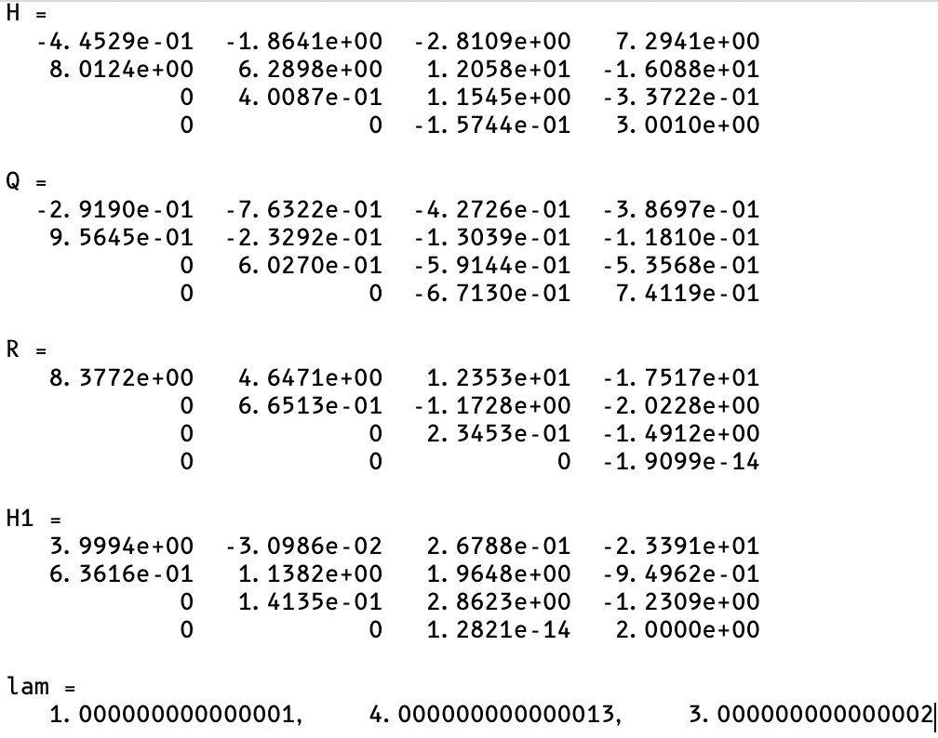
Example

Slide 41

Practical QR Algorithm
But the “pure” QR algorithm is not cubically convergent. To make it so, we must combine some ideas from the Rayleigh quotient iteration, namely the shifting:

Slide 42


Example with simple shift $H_{nn}$

Slide 43

H(4,3) quadratic convergence to 0. If H is not Hessenberg but tridiagonal, the convergence rate is cubic.
When H(4,3) is sufficiently small, we declare it to be zero, and claim we have found an eigenvalue 3.0.
Now we continue to find other m-1 eigenvalues.

Slide 44

Why does QR algorithm work?
QR algorithm is related to a more obvious method called simultaneous iteration, where you do power iteration on not only one vector but on several simultaneously.
Let’s say we have $n$ vectors ${V_{0}=[v}_{1}^{\left(0\right)}, …,v_{n}^{\left(n\right)}]$. Most likely $A^{k}v_{1}^{\left(0\right)}→q_{1}$, the largest eigenvector. By similar arguments, we could see that the subspace $<$ ${A^{k}v}_{1}^{\left(0\right)}, …,A^{k}v_{n}^{\left(n\right)}>$ converges to the subspace $<q_{1},q_{2},…,q_{n}>$.
If we take QR factorization of $A^{k}V_{0}=Q^{\left(k\right)}R^{\left(k\right)}$, we could expect $Q^{\left(k\right)}$ to converge to $Q=[q_{1},q_{2},…,q_{n}]$.
But $A^{k}V_{0}$ is becoming increasingly ill-conditioned as $k→∞.$ To make it feasible we can orthonormalize $A^{k}V_{0}$ in every iteration (remember what QR factorization does, in terms of subspace?)

Slide 45


Simultaneous Iteration
Simultaneous iterations (with $V_{0}=I$) is actually equivalent to QR algorithm.

Slide 46

Convergence and Stability
Without shifting, the QR algorithm has linear convergence (constant factor of reduction in error). With good shifting it could be cubic convergence.
Both the phase I and II are backward stable. For the symmetric eigenproblem, this means that the diagonal result satisfy:
$$\tilde{Q}\tilde{Λ}{\tilde{Q}}^{T}=A+δA, \frac{\left\|δA\right\|}{\left\|A\right\|}=O(ε_{machine})$$
Combined with the condition of symmetric eigenproblem, the forward error satisfy:
$$\frac{\left|\tilde{λ_{j}}−λ_{j}\right|}{\left\|A\right\|}=O(ε_{machine})$$

Slide 47

SVD computation
The computation of SVD of $A$ is based on EVD on the covariance matrix $A^{T}A:$
$$A=UΣV^{T}$$
$$A^{T}A=VΣ^{2}V^{T}$$
But explicitly forming $A^{T}A$ squared your condition number, thus making the process unstable. (Remember normal equation?)
Instead of computing on $A^{T}A$, there’s an alternative that does not increase the condition number:
$$H=\left[\begin{matrix}0 & A^{T} \\ A & 0\end{matrix}\right]$$
The SVD is based on implicit EVD on $H$, which is stable.

Slide 48
References
Numerical Linear Algebra, Trefethen & Bau
Matrix Computations, 4th edition.
Lecture Notes on Solving Large Scale Eigenvalue Problems, Prof. Peter Arbenz. Spring 2016

